Slide 1
Exploratory Data Analysis on Coronavirus
Under the Guidance of
Dr. R J Prathibha
By:
Anirudh D (01JST19PSE001)
Swaroop S (01JST19PSE021)

Slide 2
Objectives
To understand the dataset attributes and values for analysis of COVID-19 data.
To clean the Dataset for any noise, out layers and extract only the necessary information.
To perform exploratory data analysis on the cleaned dataset by making visual reports and understand the spread of COVD-19.

Slide 3
About the Dataset
Dataset: Novel Corona Virus Dataset.
Source: World Health Organization(WHO) and Covid19India.org
Dataset 1: 8 Columns, 52470 Rows
  (Observation Date, State, Country, Last Update, Confirmed, Deaths, Recovered)
Dataset 2: 22 Columns, 102610 Rows
  (Patient Number, State Patient Number, Date Announced, Estimated Onset Date, Age Bracket, Gender, Detected City and many more)

Slide 4
Approach
Understanding dataset.
Data Preparation.
Cleaning the dataset.
Exploratory Data Analysis
  Visualizing unique Countries and their count.
  Graph – Top countries with highest cases.
  Data Analysis on India

Slide 5
Analysis
Exploratory data analysis- Graphical Method used for Analysis
Identifying strong attributes.
Plotting graphical views on attributes.
Statistical analysis.
Creating an visual report.

Slide 6
Percentage of confirmed cases per country across the world.
Top 5 countries affected by Corona Virus.
Respective Death, Confirmed and Active cases in Bar Graph.
Analysis of Indian states with current Covid-19 case status.
Mortality Rate analysis for all states.
Top 10 states with confirmed cases analysis.
Top 10 states with Death count.
Analysis based on gender wise confirmed, recovered and Deaths in India.
Analysis based on Age wise recovered and death cases.

Slide 7
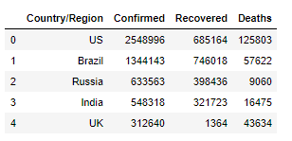
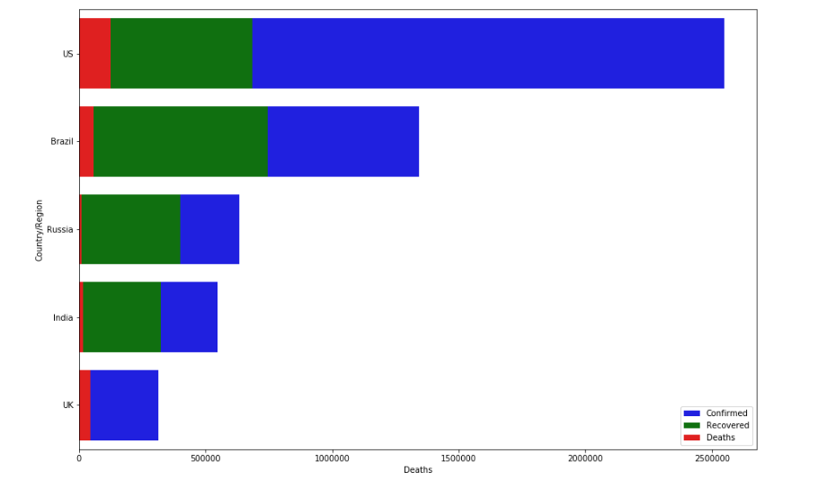
Results
Top 5 Countries affected by COVID19
Confirmed, Recovered and Death counts
for top 5 countries

Slide 8
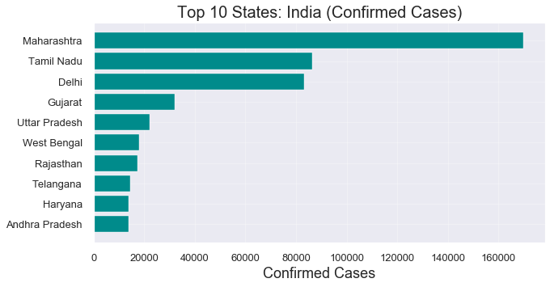
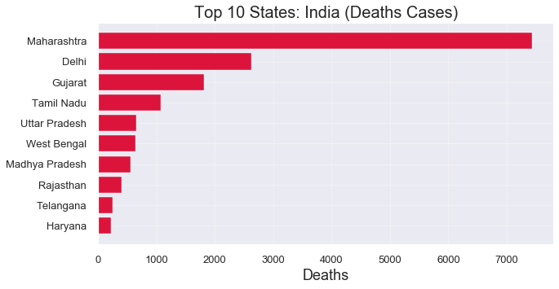
Indian Top 10 States with Highest
Confirmed Cases
Indian Top 10 States with Highest
Causalities

Slide 9
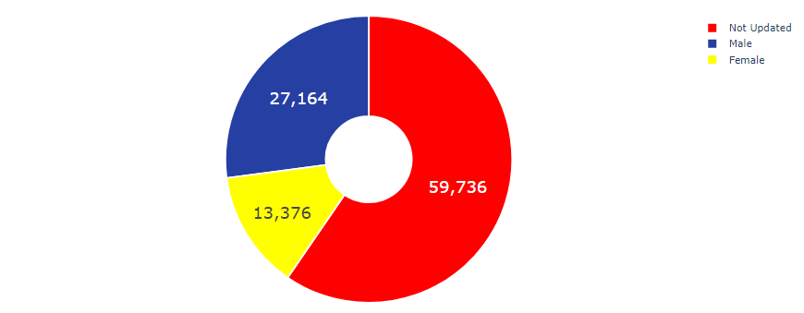
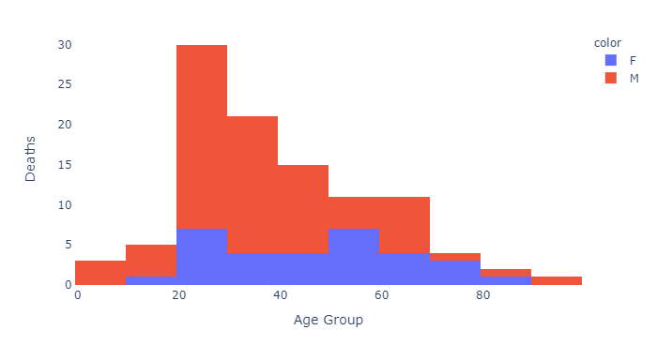
Gender wise active cases in India
Age wise cases in India

Slide 10
Conclusion
Exploratory Data Analysis on Corona Virus will help in tracking the behavior of spread of virus.
Analysis shows the growth trends of infected cases in India, the number of deaths, cured, total cases in the country.

Slide 11
Thank You

